Slide 1
PowerTeacher Pro
For Teachers New To ECPS
Matt Ponish

Slide 2
PowerTeacher Pro
Agenda
Login
PowerTeacher-Main Screen
PowerTeacher Pro-Basic Layout
Add Categories
Display Settings
Grade Setup
Add Assignments
Add Grades
Parent/Student Portal

Slide 3
PowerTeacher Pro-Login
POP QUIZ
Which one should you use to login to PowerTeacher?
This One

Slide 4
PowerTeacher Pro-Main Screen
Home Screen
Click PowerSchool
Daily Bulletin
Attendance List
Birthday List
Attendance
Used to take attendance
Back Pack
Student information
Lunch
Do Not Use
Reports
Reports you can print
Seating Chart
Have fun
PowerTeacher Pro
Launch your Gradebook

Slide 5
PowerTeacher Pro-Basic Layout
Charms
Icons on left
Select Class
Drop down at top of screen
Create
Assignments
Categories
A+ Grading
View Assignments
View Scoresheet
View Categories
Students
Assignments
Comment Log
Demographics
Quick Lookup
Settings
Class Description
Display settings
Class sort order
Turn off standards
Student names and order
Apps
Returns to PowerTeacher

Slide 6
PowerTeacher Pro-Add Categories
Click on View All tab
School House Icon-District created
Used to group assignments by type
Used by some for grading
Check indicates active

Slide 7
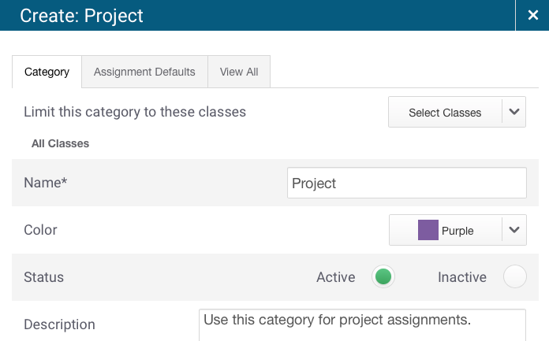
PowerTeacher Pro-Add Categories
Choose classes that will use this category
Enter name
Choose color
Choose Points or Percents
Fill in Scoring section

Slide 8
PowerTeacher Pro-Settings
Class Description
Not shown here
Display Settings
Class listings sort
Period/day
Section #
Course #
Traditional Grade
Show Grade, Percent, and/or Points
Standards Usage
Turn it off (except for KG)
Student Names
Last-first, First-last, etc
Sort by Options
Last or First
Option to add newly enrolled students to the bottom of list

Slide 9
PowerTeacher Pro-Grade Setup-Total Points
Y1 will be setup at district level-Locked at TES
For EIS and EHS, S1 and S2 will be setup at district level
You setup Q1, Q2, Q3, Q4
If you do total points, you have nothing to setup
Otherwise click on Pencil
Copying from one class or different terms to other classes or terms still not available

Slide 10
PowerTeacher Pro-Grade Setup
Click on + to add more items in the type column
Select the category and weight
Click – to remove selection

Slide 11
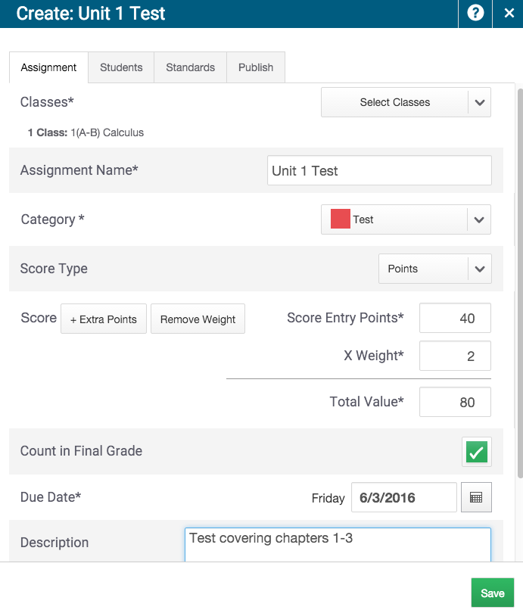
PowerTeacher Pro-Add Assignment
Click create at top of screen and select assignment
Choose the classes for this assignment
Enter a name
Select the category
Adjust score type and score if necessary
Enter Due Date
Add description-optional

Slide 12
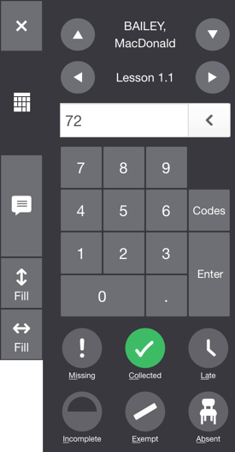
PowerTeacher Pro-Adding Grades
Click A+ Charm and select scoresheet
Select the assignment
Use keyboard to enter score
Use keypad on right to enter scores
Click text bubble to enter comment
Or use box under keypad
Click keypad to enter grades
Enter score indicators (missing, late, etc)
Adjust/Manually Override Average
Click on box under Course Grade
Enter the adjustment
A small triangle will appear in upper left corner

Slide 13
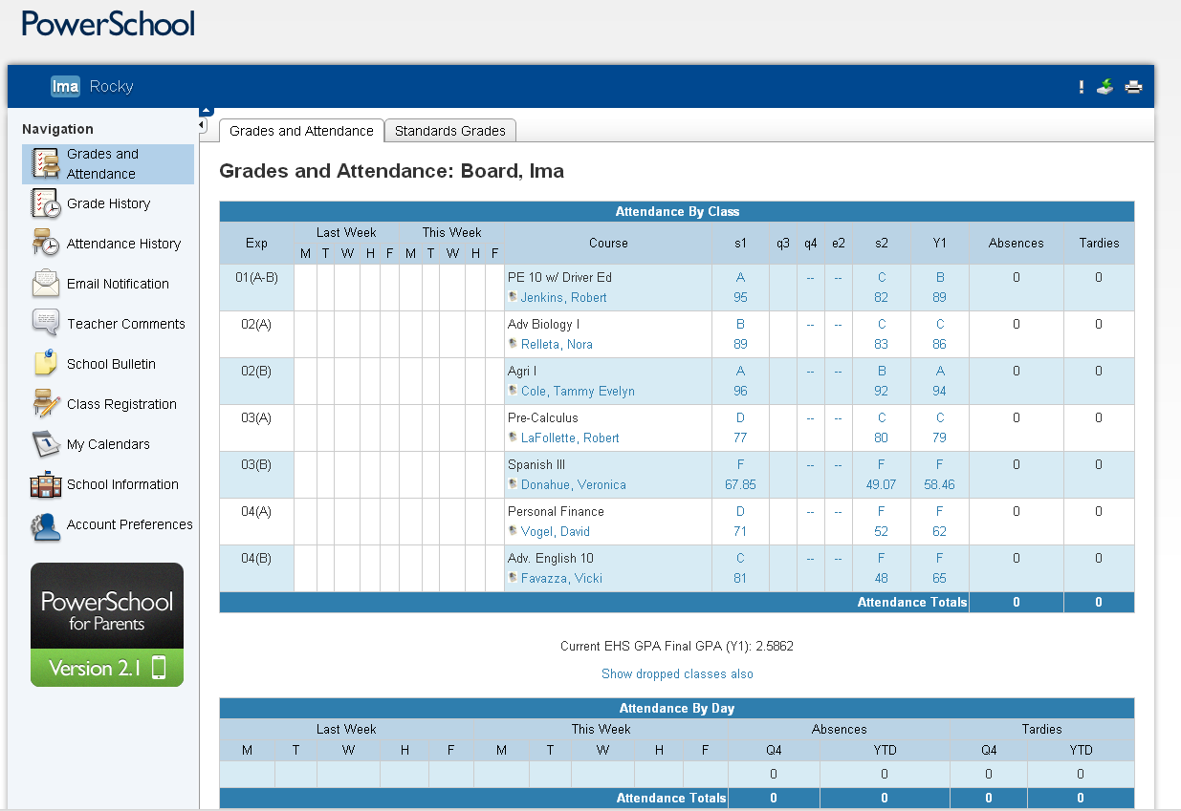
PowerTeacher Pro-Parent/Student Portal
Classes
Description if blue (link)
Letter Grades
Individual assignments
Percents
Attendance
Very important to take attendance each block/period
Comments
Be careful what you say
Spelling-grammer
Email notification
Daily-weekly
Your email address

Slide 14
PowerTeacher Pro
Questions ?

Slide 15
PowerTeacher Pro
Matt Ponish
mponish@essex.k12.va.us
804-443-2140-direct line
Sorry but no voice mail
Semi Retired
Part Time-7:00-11:00

