Slide 1
PowerTeacher Pro
For Teachers
Matt Ponish

Slide 2
PowerTeacher Pro
Agenda
Login
PowerTeacher-Main Screen
PowerTeacher Pro-Basic Layout
Adding Categories
Display Settings
Grade Setup
Adding Assignments
Adding Grades
Parent/Student Portal
Add Category
Add Assignment
Work with Grade Setup

Slide 3
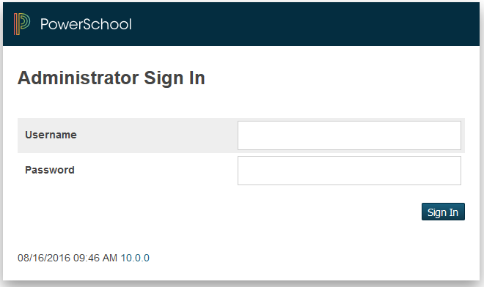
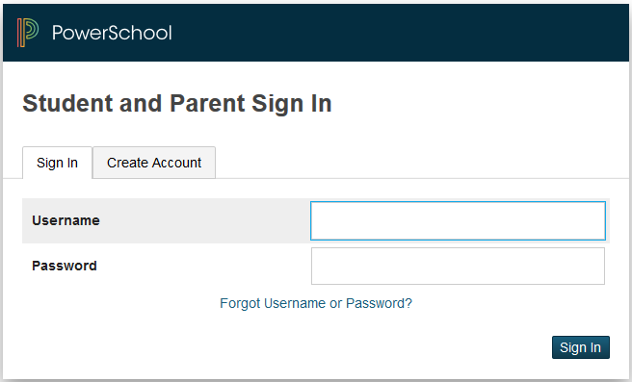
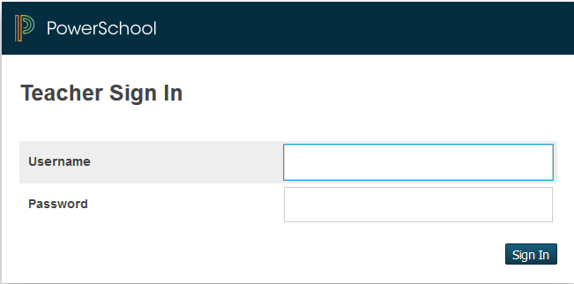
PowerTeacher Pro-Login
POP QUIZ
Which one should you use to login to PowerTeacher?
This One

Slide 4
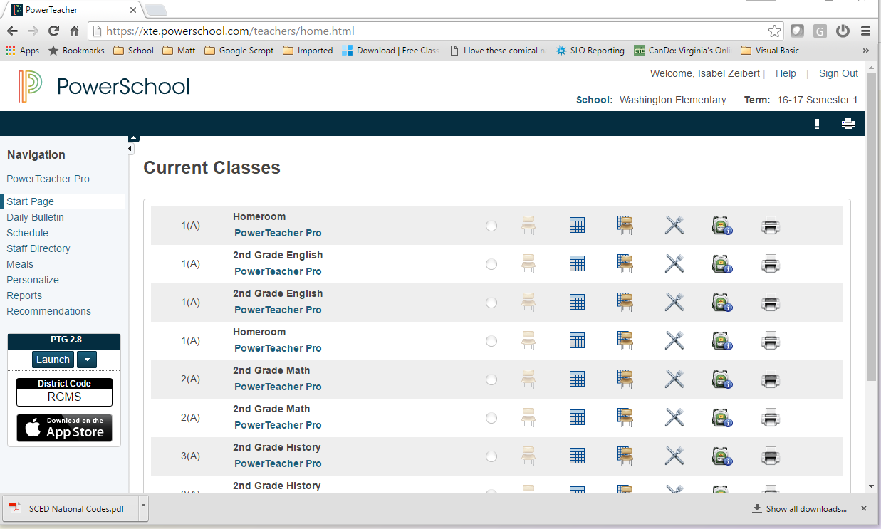
PowerTeacher Pro-Main Screen
Home Screen
  Click PowerSchool
Daily Bulletin
  Attendance List
  Birthday List
Attendance
  Used to take attendance
Back Pack
  Student information
Lunch
  Do Not Use
Reports
  Reports you can print
Seating Chart
  Have fun
PowerTeacher Pro
  Launch your Gradebook

Slide 5
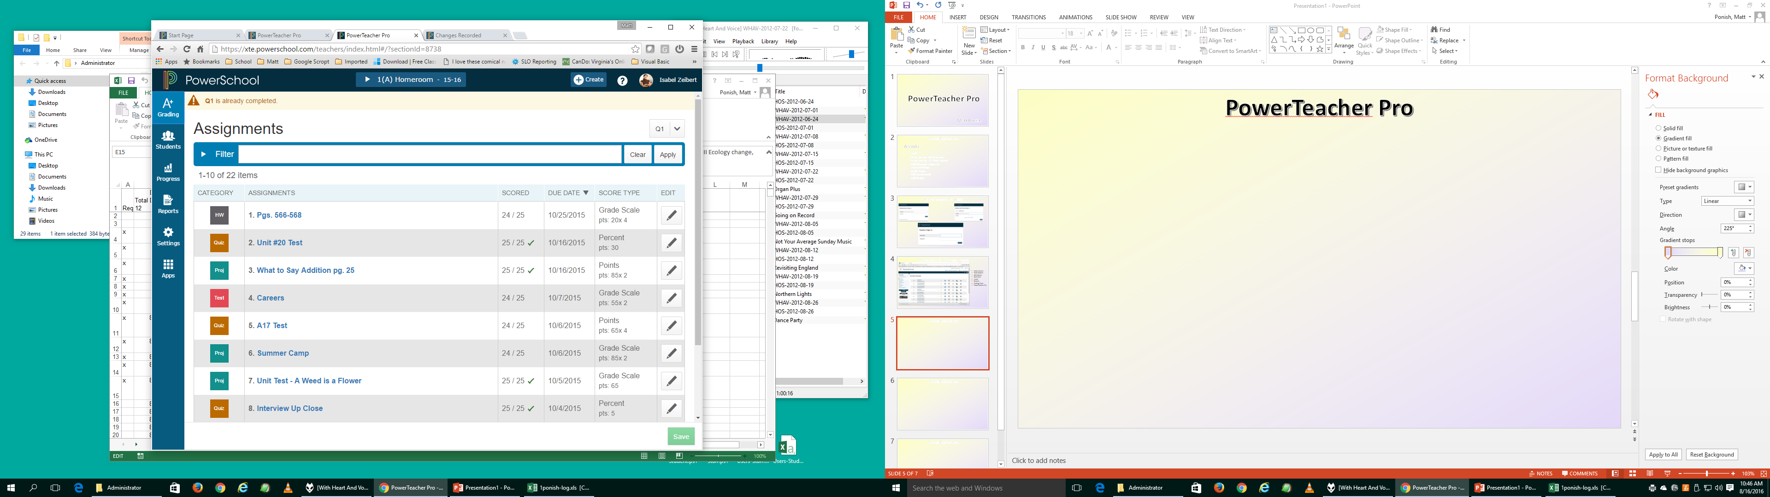
PowerTeacher Pro-Basic Layout
Charms
  Icons on left
Select Class
  Drop down at top of screen
Create
  Assignments
  Categories
A+ Grading
  View Assignments
  View Scoresheet
  View Categories
Students
  Assignments
  Comment Log
  Demographics
  Quick Lookup
Settings
  Class Description
  Display settings
    Class sort order
    Turn off standards
    Student names and order
Apps
  Returns to PowerTeacher

Slide 6
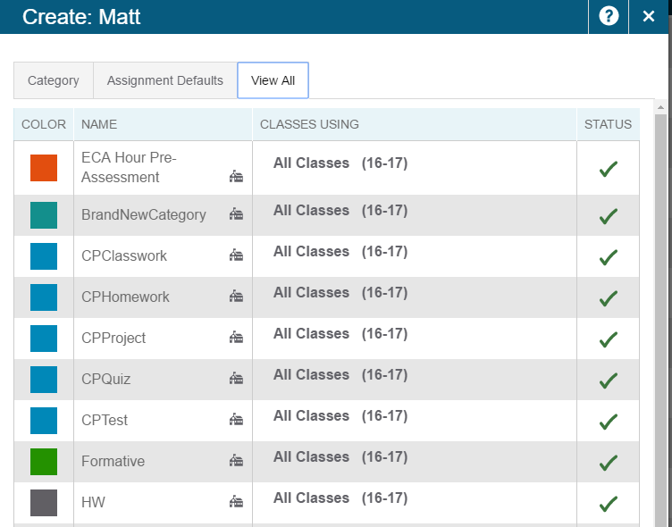
PowerTeacher Pro-Adding Categories
Click on + Create
Click on View All tab
School House Icon-District created
Used to group assignments by type
Used by some for grading
Check indicates active

Slide 7
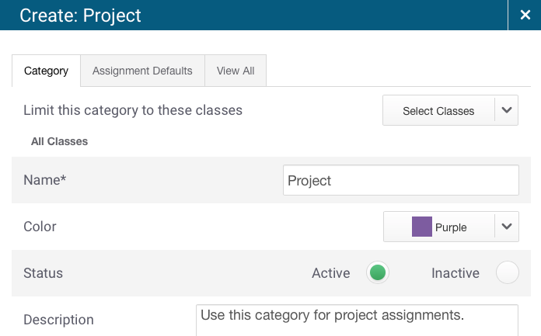
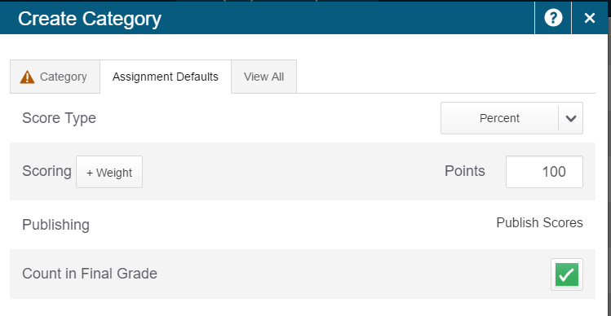
PowerTeacher Pro-Adding Categories
Choose classes that will use this category
Enter name
Choose color
Choose Points or Percents
Fill in Scoring section
You can edit Assignment Defaults-District

Slide 8
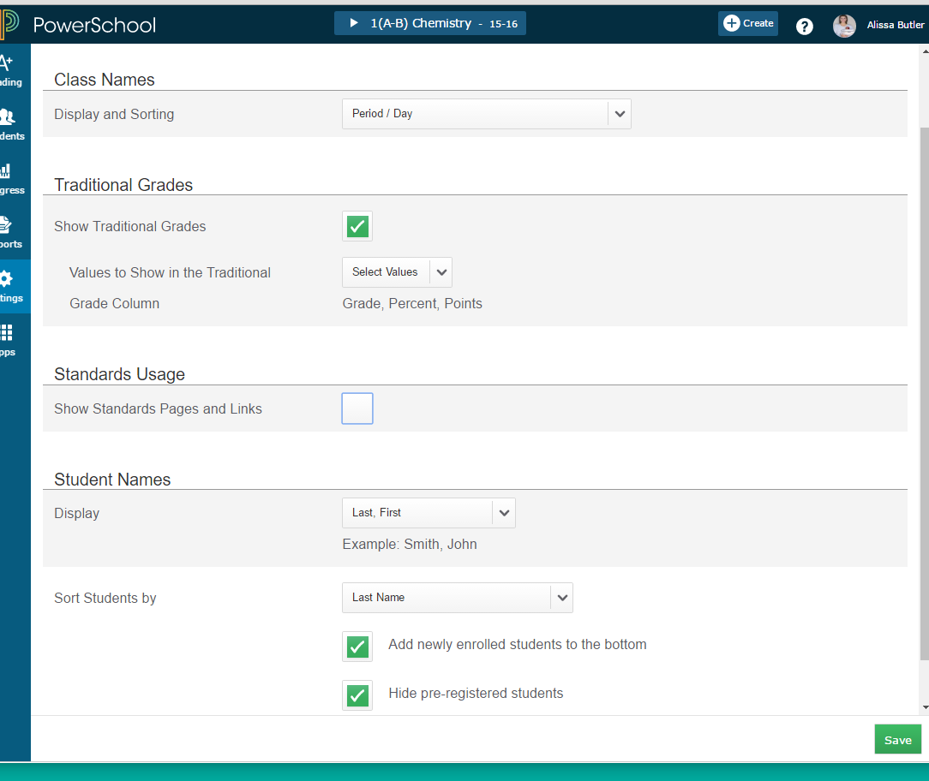
PowerTeacher Pro-Settings
Class Description
  Not shown here
Display Settings
  Class listings sort
    Period/day
    Section #
    Course #
  Traditional Grade
    Show Grade, Percent, and/or Points
  Standards Usage
    Turn it off (except for KG)
  Student Names
    Last-first, First-last, etc
    Sort by Options
      Last or First
    Option to add newly enrolled students to the bottom of list

Slide 9
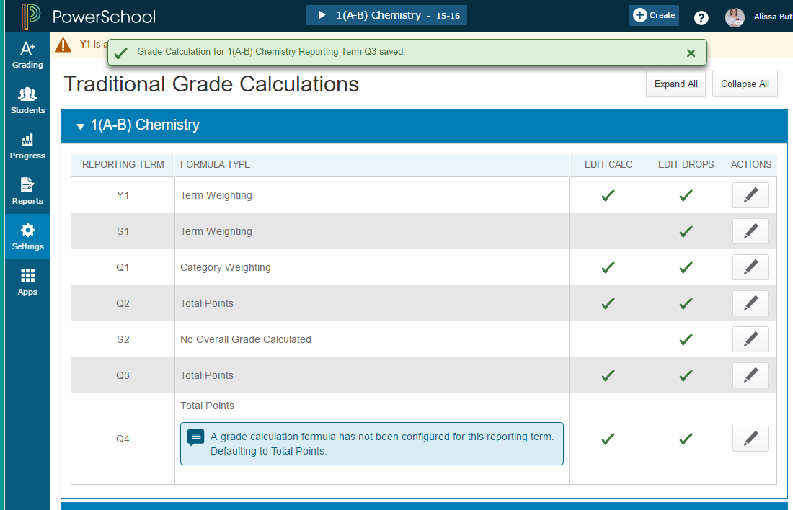
PowerTeacher Pro-Grade Setup-Total Points
Y1 will be setup at district level
For EIS and EHS, S1 and S2 will be setup at district level
You setup Q1, Q2, Q3, Q4
  If you do total points, you have nothing to setup
  Otherwise click on Pencil

Slide 10
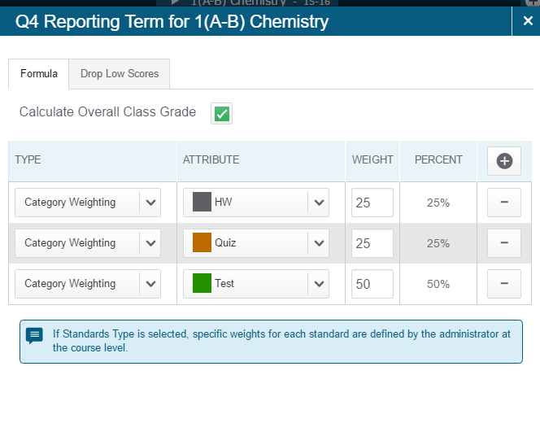
PowerTeacher Pro-Grade Setup
Click on + to add more items in the type column
Select the category and weight
Click – to remove selection

Slide 11
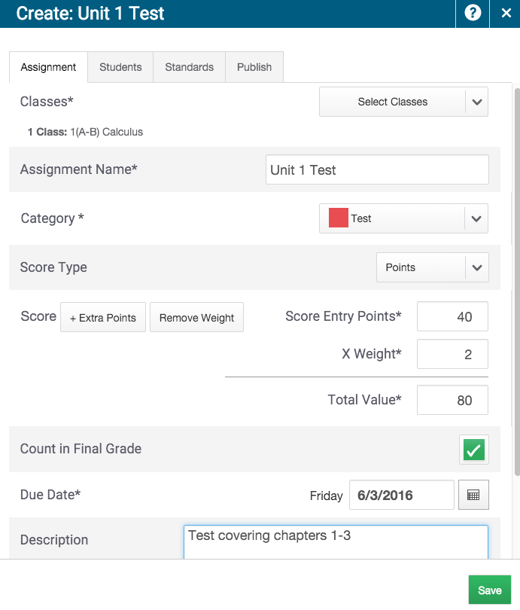
PowerTeacher Pro-Adding Assignment
Click + Create at top of screen and select assignment
Choose the classes for this assignment
Enter a name
Select the category
Adjust score type and score if necessary
Enter Due Date
Add description-optional

Slide 12
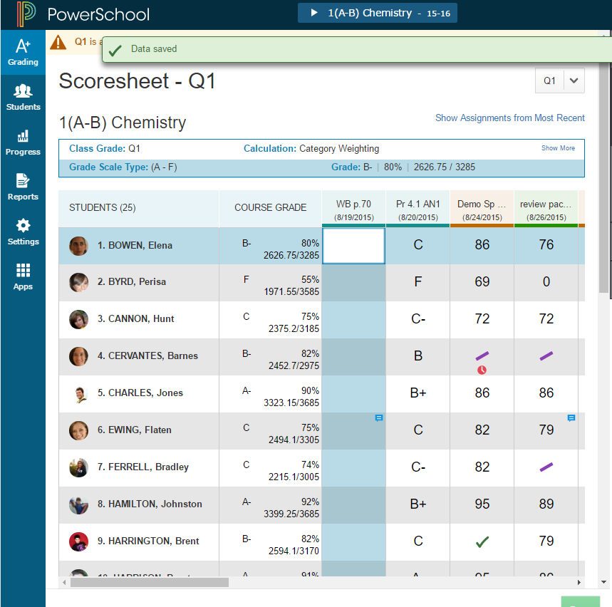
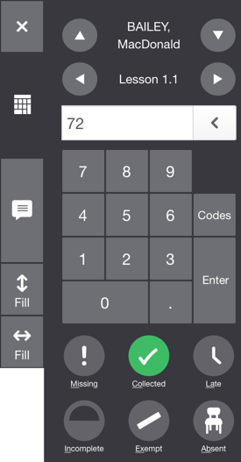
PowerTeacher Pro-Adding Grades
Click A+ Charm and select scoresheet
Select the assignment
Use keyboard to enter score
Use keypad on right to enter scores
Click text bubble to enter comment
  Or use box under keypad
Click keypad to enter grades
Enter score indicators (missing, late, etc)
Adjust/Manually Override Average
Click on box under Course Grade
Enter the adjustment
  A small triangle will appear in upper left corner

Slide 13
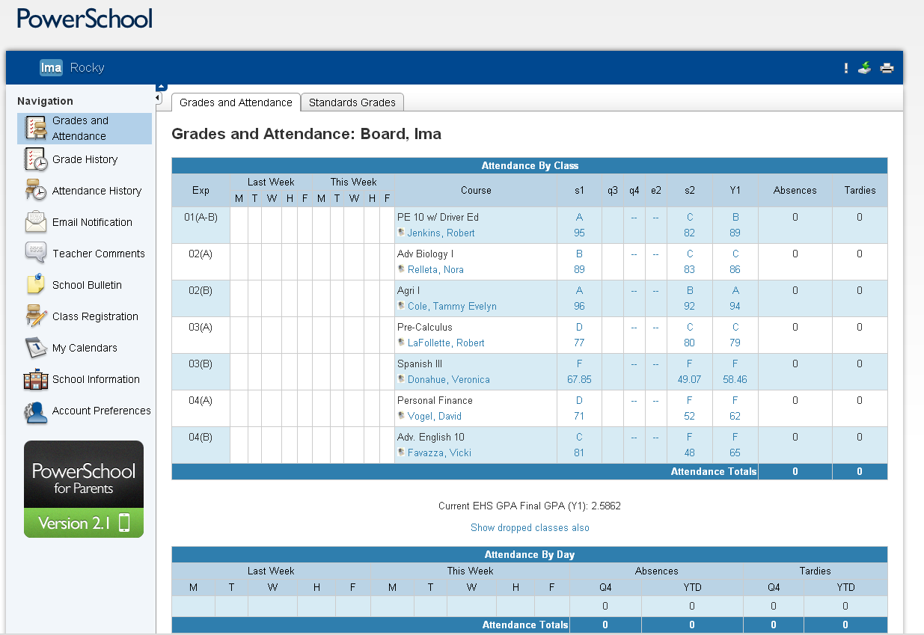
PowerTeacher Pro-Parent/Student Portal
Classes
  Description if blue (link)
Letter Grades
  Individual assignments
Percents
Attendance
  Very important to take attendance each block/period
Comments
  Be careful what you say
  Spelling-grammer
Email notification
  Daily-weekly
Your email address

Slide 14
PowerTeacher Pro-Add Assignment
To Add Assignment
  Click + Create
  Click Assignment
  Click Select Classes if you wish to add this to multiple classes
  Enter a name for this assignment
  Select a category
  Adjust Score Type, Score, Score Entry Points (if needed)
  Enter Due Date
  Enter Discription-Optional
  Save
  Click Students to Add/Remove students from assignment
  Save

Slide 15
PowerTeacher Pro-Add Category
To Add Category
  Click + Create
  Select Classes-Optional
  Enter a name for this category
  Choose a color
  Enter a description-Optional
  Save
  Select a score type-(Points or Percents)
  Enter default points
  Save

Slide 16
PowerTeacher Pro-Working with Grade Setup
Click the Settings charm
  Click Traditional Grade Calculations
  Collapse or Expand the Grade Setup for the class with the little triangle in front of the class name
  You should only adjust Q1, Q2, Q3, and Q4
  Adjust the Type, Attribute, Weight
  Click + to add row if needed
  Save

Slide 17
PowerTeacher Pro
Questions ?

Slide 18
PowerTeacher Pro
Matt Ponish
mponish@essex.k12.va.us
804-443-2140-direct line
Sorry but no voice mail
Semi Retired
Part Time-7:00-11:00

